Slide 1
Class 2 Permit Modification Request
Revise Site Recertification Audit Scheduling from Annual to Graded Approach
https://wipp.energy.gov/2024-information-repository-documents.asp

Slide 2
Summary of Changes
This Permit Modification Request (PMR) allows the Permittees to consolidate audit scheduling information into Permit Attachment C6, Section C6-1, in order to remove redundancy and clarify subsequent audits.
This PMR adds a graded approach-based scheduling criteria for generator/storage site recertification audits to Permit Attachment C6, Section C6-1, Introduction:
replacement of the contracting organization performing the transuranic (TRU) waste management,
new Permit-related waste characterization activities,
changes in waste types or forms,
quantity of waste being characterized,
unexpected issues or events,
results of previous audits, and
input received from the New Mexico Environment Department (NMED).
Notes:
• replacement of the contracting organization performing the TRU waste management,
Audits may be required to assess the performance of new contracting organizations. This will depend on the level of change. For example, changes to a management and operating contractor may have no impact on waste characterization activities; however, changes to subcontractors performing Permit-required waste characterization testing activities may require evaluation. The DOE will consider these changes in scheduling audits.
• new Permit-related waste characterization activities (e.g., new RTR or VE processes),
Sometimes new equipment or new waste characterization test methods are deployed at sites. This may require audit or surveillance, depending on the significance of the change. The DOE will consider these changes in scheduling audits.
• changes in waste types or forms (e.g., additional Summary Category Groups not previously approved by the NMED),
Characterization of waste per each Summary Category Group (Homogeneous Solids [Summary Category S3000], Soil/Gravel [Summary Category S4000], and Debris Waste [Summary Category S5000]) is evaluated in audits. For example, the initial audit may have only included one Summary Category Group, and another is added later. The DOE will consider changes In Summary Category Groups in developing the annual audit schedule.
• quantity of waste being characterized,
Some generator/storage sites (e.g., small quantity sites) may be characterizing and shipping only small volumes of waste (i.e., few containers). The CCP is certified at these sites and is characterizing waste on an as-needed basis. The DOE will consider the quantity of waste being characterized and the shipping rates at generator/storage sites in developing the annual audit schedule.
• unexpected issues and events,
The DOE will consider reportable occurrences in developing the audit schedule.
• results of previous audits, and
The DOE will consider the results of previous audits and surveillances in developing the annual schedule. Generator/storage sites with good performance may only be required to be audited once within a 3-year period, while those with poor performance (e.g., many conditions adverse to quality previously identified) or complex compliance history may have to be audited annually. Because audits significantly impact resources at generator/storage sites, this criterion will serve as an incentive for maintaining good performance.
• input received from the NMED.
The NMED observes generator/storage site audits and is very familiar with their waste characterization programs. The DOE will consider input from the NMED in developing the annual audit schedule.

Slide 3
Summary of Changes
The Department of Energy (DOE) will perform an audit at least once every 3 years at each generator/storage site shipping TRU mixed waste (active site) to the Waste Isolation Pilot Plant (WIPP) facility. This schedule is appropriate for the following reasons:
The DOE reviews and approves data quality-affecting changes to generator/storage site plans and procedures prior to them being implemented.
The Central Characterization Program (CCP) procedures are common to each of their certified sites, as well as similar Advanced Mixed Waste Treatment Project procedures.
Few data quality-affecting changes have been made to the Waste Analysis Plan (WAP) since 2013.
The NMED will provide input and approve the annual audit schedule. The NMED observes generator/storage site audits and is familiar with their programs.
The DOE will perform surveillances as indicated in the Permit, on an as-needed basis.
Please note that the requirement for performing initial audits prior to shipment of waste to the WIPP facility is not being changed.

Slide 4
Classification
This PMR revises the Permit to allow a graded approach for scheduling site recertification audits.
Pursuant to 20.4.1.900 New Mexico Administrative Code (NMAC) (incorporating 40 CFR §270.42 Appendix I), the graded approach for scheduling site certification audits is identified as a Class 2 PMR.
20.4.1.900 NMAC, incorporating 40 CFR §270.42, Appendix I, B. General Facility Standards, 1. Changes to waste sampling or analysis methods, d. Other changes…2

Slide 5
Reasons the Modification is Needed
This PMR is needed to add graded approach-based criteria (consistent with DOE Orders) for scheduling generator/storage site recertification audits. Graded approach is defined as:
“The process by which the level of analysis, documentation, verification, and other controls necessary to comply with [Quality Assurance] QA program requirements are developed commensurate with specified factors.” U.S. DOE, Carlsbad Field Office, Quality Assurance Program Document, DOE/CBFO-94-1012
The specified factors are the criteria being added to Permit Attachment C6, Section C6-1, Introduction.
This PMR is needed for the following reasons:
to reduce redundant procedure reviews,
to ensure resources are efficiently applied, and
to place audit focus on areas of greatest importance and provide incentive for generator/storage sites to perform continuously at a high level.

Slide 6
Applicable Information Included in the Permit Modification Request
This PMR provides the necessary information required by 20.4.1.900 NMAC (incorporating 40 CFR §270.42(b)(1)(iv)) including the applicable information required by 40 CFR §§270.13 through 270.21, 270.62, and 270.63.

Slide 7
Summary
Utilizing the graded approach will reduce redundancy, and allow the DOE to focus audit team resources where needed, resulting in overall resource/cost savings. Additionally, by placing audit focus on areas of greatest importance, it will serve as an incentive for maintaining good performance.
These changes do not reduce the ability of the Permittees to determine that the waste generator/storage sites have effectively implemented and comply with applicable requirements of the WAP, and thereby provide continued protection to human health and the environment.

Slide 8
Class 2 Permit Modification Request
Addition of Four New Shielded Containers
https://wipp.energy.gov/2024-information-repository-documents.asp

Slide 9
Summary of Changes
This Permit Modification Request (PMR) adds new text to the Permit, changes existing text in the Permit, and changes existing Permit figures and tables, as appropriate to reflect the addition of four new shielded containers.
This PMR adds four new shielded containers to the Waste Isolation Pilot Plan (WIPP) facility Permit (SC-30G2, SC-30G3, SC-55G1, and SC-55G2) as transuranic (TRU) mixed waste storage and disposal containers.
Notes:
Revised Permit Part 3, Section 3.3.1.8., Shielded Container*:
to add a new table (Table 3.3.1.8) to add the respective volume for each shielded container
Revised Permit Part 4, Section 4.3.1.8.,
Revised Permit Attachment A1, Section A1-1b(2),
Revised Permit Attachment A1, Section A1-1c(1),
Revised Permit Attachment A1, Section A1-1c(1),
Revised Permit Attachment A1, Section A1-1c(1),
Revised Permit Attachment A1, Section A1-1d(2),
Revised Permit Attachment A1, Section A1-1d(4),
Revised Permit Attachment A1, Table A1-1
Revised Permit Attachment A1, Table A1-2,
Revised Permit Attachment A2, Section A2-2a(1),
Revised Permit Attachment A2, Table A2-1, Revised Permit Attachment A3, Section A3-3,
Revised Permit Attachment C, Section C-5a(1),
Revised Permit Attachment C, Section C-5b(2),
Revised Permit Attachment E, Table E-1,
Revised Permit Attachment M, Figures, List of Figures,
Revised Permit Attachment M, Figures, Figure M-11,

Slide 10
Draft Revisions for Permit Attachment A1, Table A1-1, TRU Mixed Waste Containersª
DESCRIPTION | VOLUME |  | DIMENSIONS (inches) |  |  | LINER | USE FOR DERIVED WASTE | FIGURE
 | CUBIC FEET | CUBIC METERS | LENGTH | WIDTH OR DIAMETER | HEIGHT
55-gal (208-L) drum | 7.4 | 0.21 | N/A | 24 | 35 | Optional | Yes | M-3
Standard waste box | 66.3 | 1.88 | 71 | 54 | 36 | No | Yes | M-4
Ten-drum overpack | 160 | 4.5 | N/A | 72 | 73 | No | Yes, in under-ground | M-5
85-gal (322-L) drum | 11.4 | 0.32 | N/A | 26 | 36 | Optional | Yes | M-6
100-gal (379-L) drum | 13.4 | 0.38 | N/A | 32 | 35 | Optional | No | M-7
Standard large box 2 | 261 | 7.39 | 108 | 69 | 73 | No | No | M-8
Facility canister | 31.4 | 0.89 | N/A | 28 | 117 | No | No | M-9
RH TRU canister | 31.4 | 0.89 | N/A | 26 | 120 | Insert optional | No | M-10
Shielded containers SC-30G1^{b} | 7.4 | 0.21 | N/A | 23 | 36 | 1 inch of lead shielding | No | M-11
SC-30G2^{b} | 8.3 | 0.24 | N/A | 24.5 | 36.625 | 1.5 inch of lead shielding | No | M-11
SC-30G3^{b} | 11.4 | 0.33 | N/A | 28 | 42.25 | 2.75 inch of lead shielding | No | M-11
SC-55G1^{b} | 10.4 | 0.30 | N/A | 29.375 | 40.5 | 2.25 inch of steel shielding | No | M-11
SC-55G2^{b} | 16.1 | 0.46 | N/A | 31 | 45.75 | 2 inch of lead shielding | No | M-11
N/A Not applicable to drums ª TRU mixed waste containers may also be used to overpack waste containers that, upon removal from the shipping package, have been determined to be leaking or not in good condition. ^{b} “SC” = Shielded Container

Slide 11
Shielded Container Information
On April 28, 2022, the four new shielded containers were approved by the Nuclear Regulatory Commission (NRC).
These containers are robust and safe as demonstrated by rigorous testing and analysis, which is discussed in the NRC Safety Evaluation Report (SER).
These containers meet Department of Transportation 7A specifications.
Notes:
Nuclear Regulatory Commission (NRC). 2022. Certification of Compliance No. 9279 for HalfPACT Shipping Package, Docket No. 71-9279. Revision 10. April 28, 2022. NRC Storage and Transportation Licensing Branch, Division of Fuel Management, Office of Nuclear Material Safety and Safeguards. Washington, D.C

Slide 12
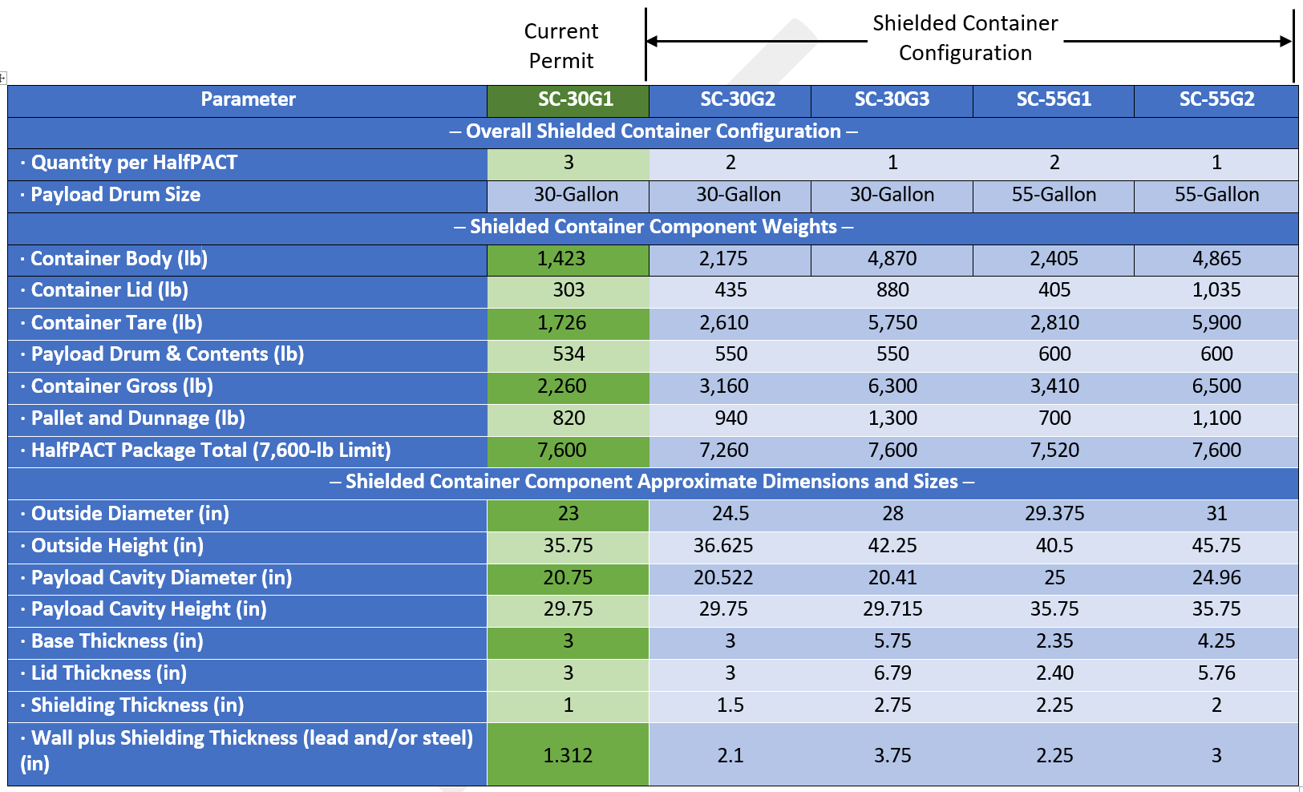
Shielded Container Information cont.

Slide 13
Classification
This PMR addresses the addition of four new shielded containers.
Pursuant to 20.4.1.900 New Mexico Administrative Code (NMAC) (incorporating 40 CFR §270.42 Appendix I), the addition of four new shielded containers is identified as a Class 2 PMR.
20.4.1.900 NMAC incorporating 40 CFR 270.42, Appendix I, Item F, Containers, 4. Storage or treatment of different wastes in containers: b, that do not require the addition of units or a change in the treatment process or management standards, and provided that the units have previously received wastes of the same type …1*
However, pursuant to 40 CFR §270.42(a)(3), the Permittees may elect to follow the procedures in 40 CFR §270.42(b) for Class 2 modifications instead of the Class 1 procedures. Therefore, the Permittees are electing to follow the Class 2 procedures in 40 CFR §270.42(b) pursuant to 40 CFR §270.42(a)(3).

Slide 14
Reasons the Modification is Needed
The changes described in this PMR are needed to support and continue the management of remote-handled (RH) TRU mixed waste as contact-handled (CH) TRU mixed waste at the WIPP facility.
The four new shielded containers will allow the generator/storage sites to proceed with their RH TRU mixed waste shipments for disposal at the WIPP facility. This will allow the Permittees to emplace RH TRU mixed waste in active waste panels during the suspension of RH TRU mixed waste activities.
The Permittees have determined that most of the RH TRU mixed waste inventory stored at generator/storage sites can be safely shipped and disposed at the WIPP facility by utilizing four new shielded containers.

Slide 15
Applicable Information Included in the Permit Modification Request
This PMR provides the necessary information required by 20.4.1.900 NMAC (incorporating 40 CFR §270.42(b)(1)(iv)) including the applicable information required by 40 CFR §§270.13 through 270.21, 270.62, and 270.63.

Slide 16
Summary
This PMR adds four new shielded containers to support and continue the management of RH TRU mixed waste as CH TRU mixed waste at the WIPP facility.
This PMR does not alter the TRU mixed waste management standards already authorized by the Permit at the WIPP facility (i.e., RH TRU mixed waste received in shielded containers will be managed and stored as CH TRU mixed waste in accordance with 40 CFR Part 264, Subpart I).
This PMR does not alter the TRU mixed waste management practices already authorized by the Permit at the WIPP facility.
This PMR does not reduce the ability of the Permittees to provide continued protection of human health and the environment.

Slide 17
Questions?

Slide 18
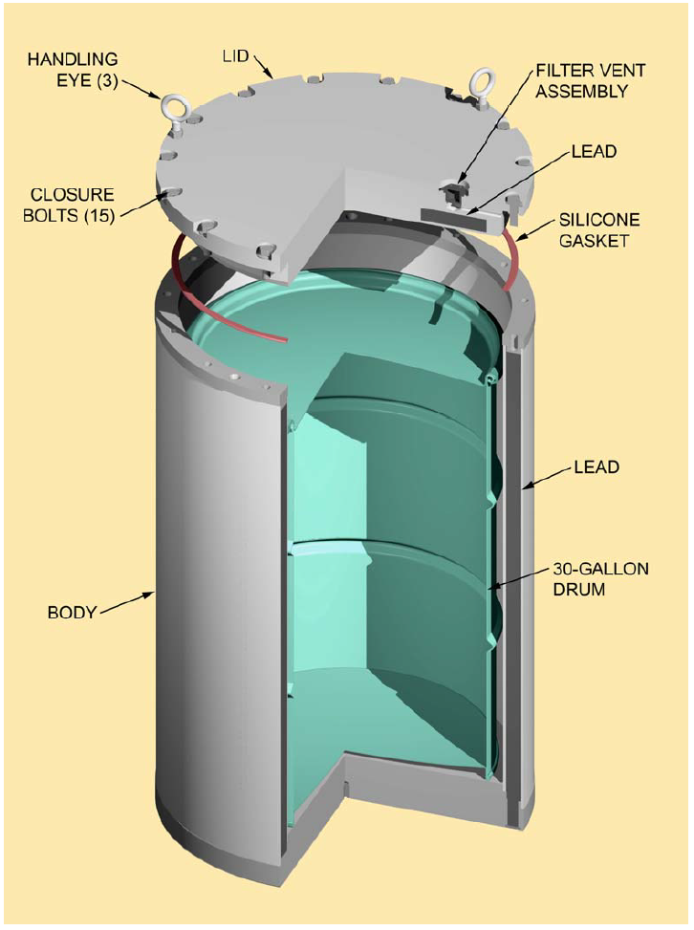
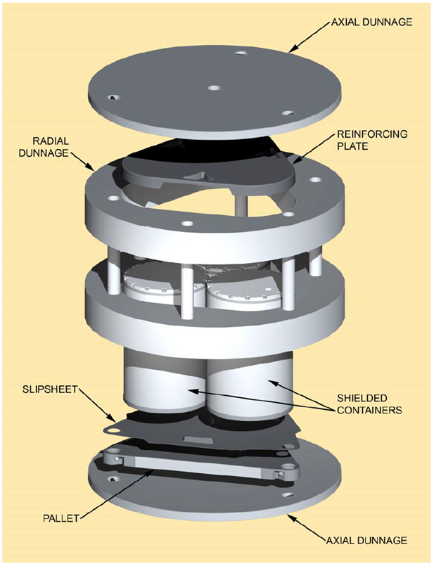
SC-30G1 Shielded Container and Container Assembly (Authorized under the current Permit) [The NMED approved a Class 2 PMR on November 1, 2012]

Slide 19
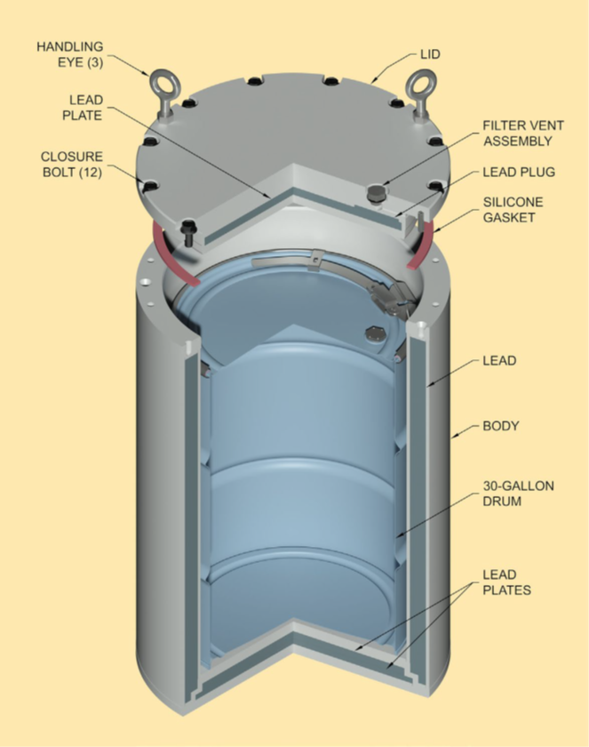
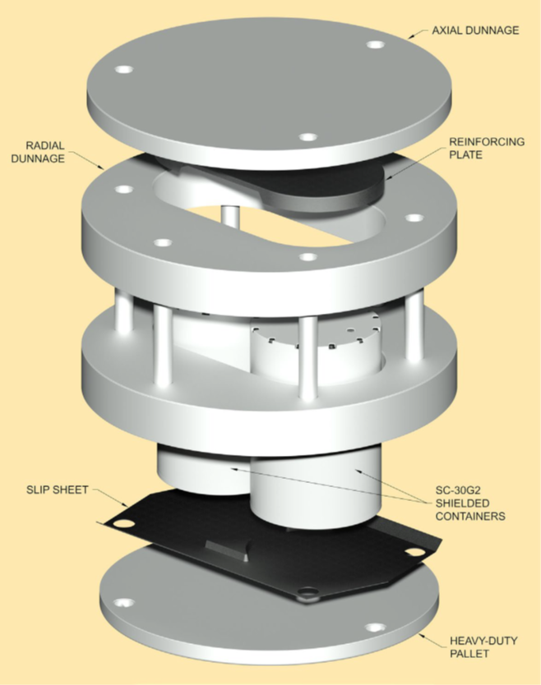
New SC-30G2 Shielded Container and Container Assembly

Slide 20
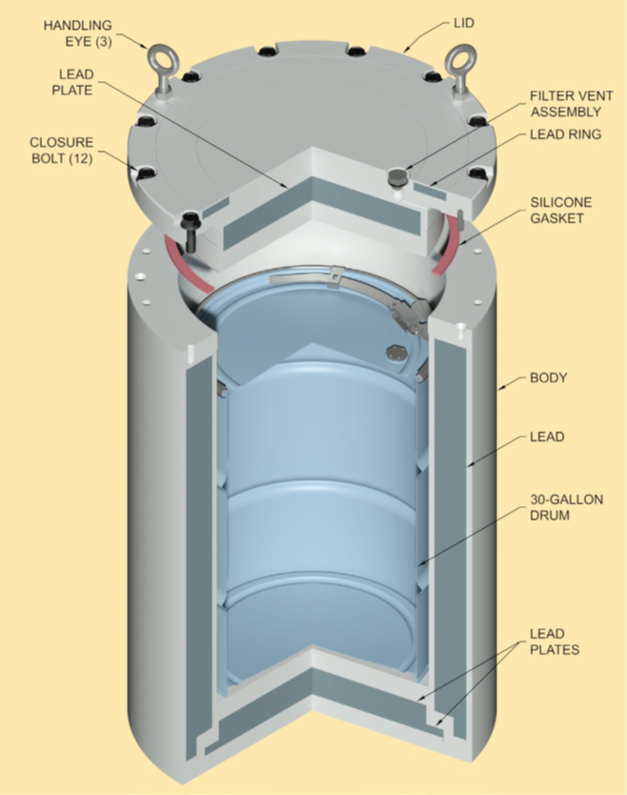
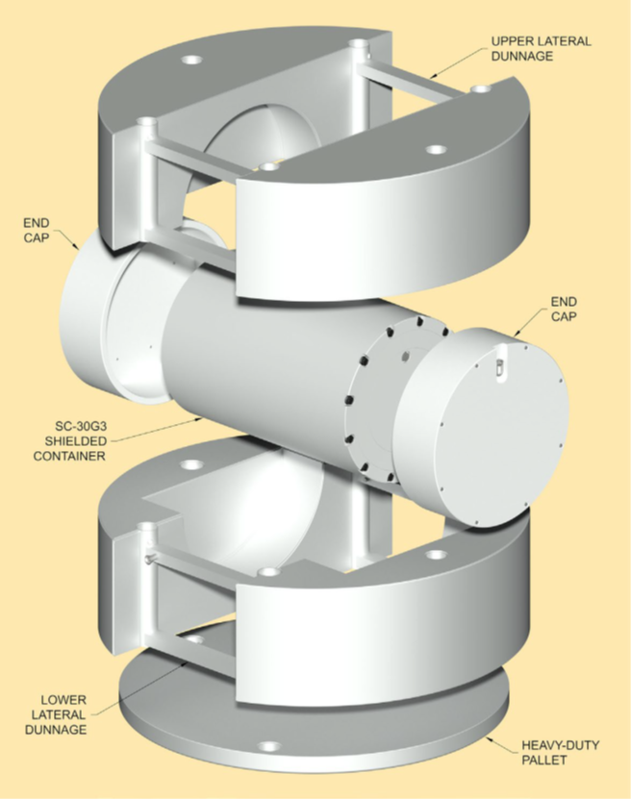
New SC-30G3 Shielded Container and Container Assembly

Slide 21
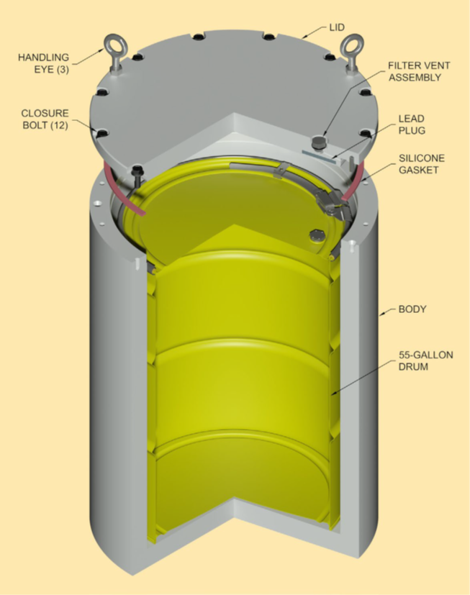
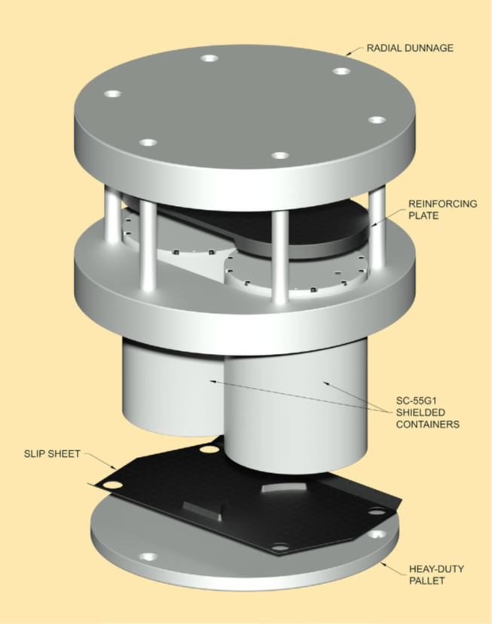
New SC-55G1 Shielded Container and Container Assembly

Slide 22
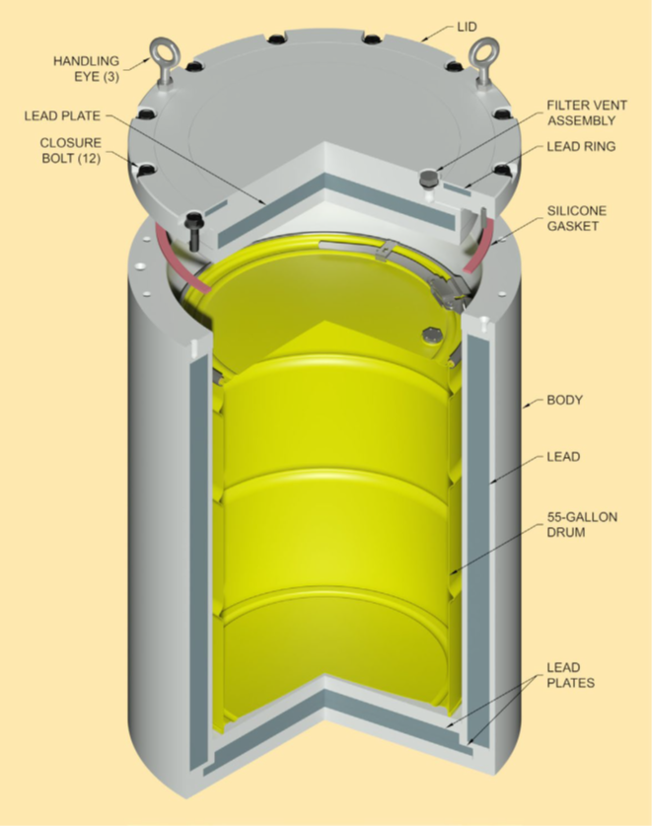
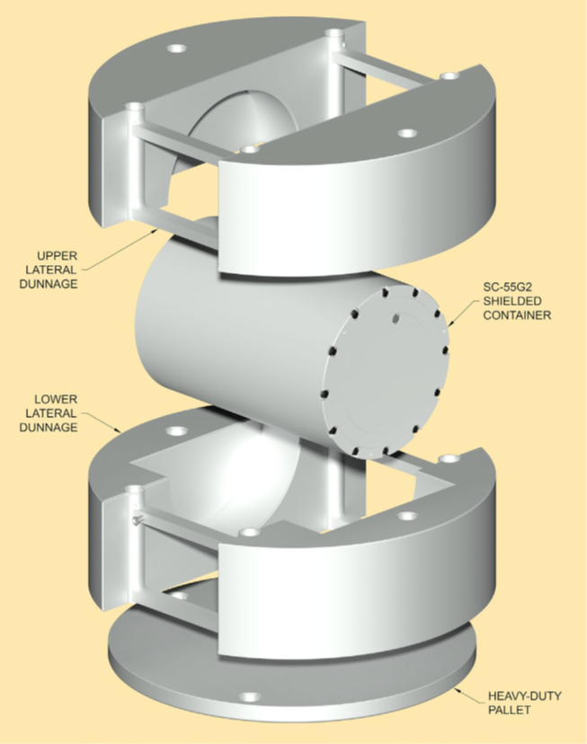
New SC-55G2 Shielded Container and Container Assembly

